Slide 1
Capstone Project
The Battle of Neighborhoods – By Amit bendre

Slide 2
Introduction & Problem Statement
In this project, we study two important cities Manhattan & Toronto. The objective of the study is to segment areas of Manhattan & Toronto into most common places using Foursquare API.
Using segmentation and clustering, we aim to find out similarities and dissimilarities of both the cities.
The target audience of this project are tourists who wish to finalize their travel plan based on the findings.

Slide 3
Data
We will use the Foursquare API to explore neighborhoods in New York/Manhattan. We will use the explore function to get the most common venue categories in each neighborhood, and then use this feature to group the neighborhoods into clusters.
For Manhattan dataset exists for free on the web. Link to the dataset: https://geo.nyu.edu/catalog/nyu_2451_34572
For the Toronto neighborhood data, a Wikipedia page exists that has all the information we need to explore and cluster the neighborhoods in Toronto. You will be required to scrape the Wikipedia page and wrangle the data.
Dataset link for Canada/Toronto: https://en.wikipedia.org/wiki/List_of_postal_codes_of_Canada:_M

Slide 4
Methodology
We have used k-means Clustering to segment the neighborhoods.
With k-means Clustering we aim to group neighborhoods together based on similar characteristic.
Once we get Cluster groups of both Manhattan & Toronto, we do compare and contract to see how these two cities are identical and different.

Slide 5
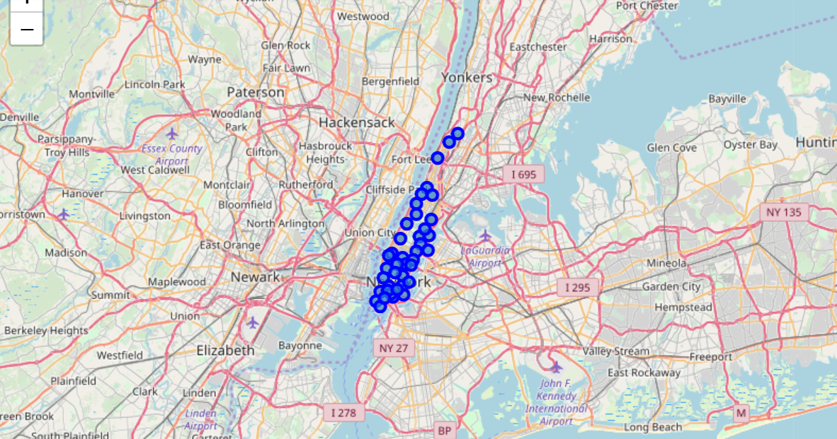
Manhattan Map

Slide 6
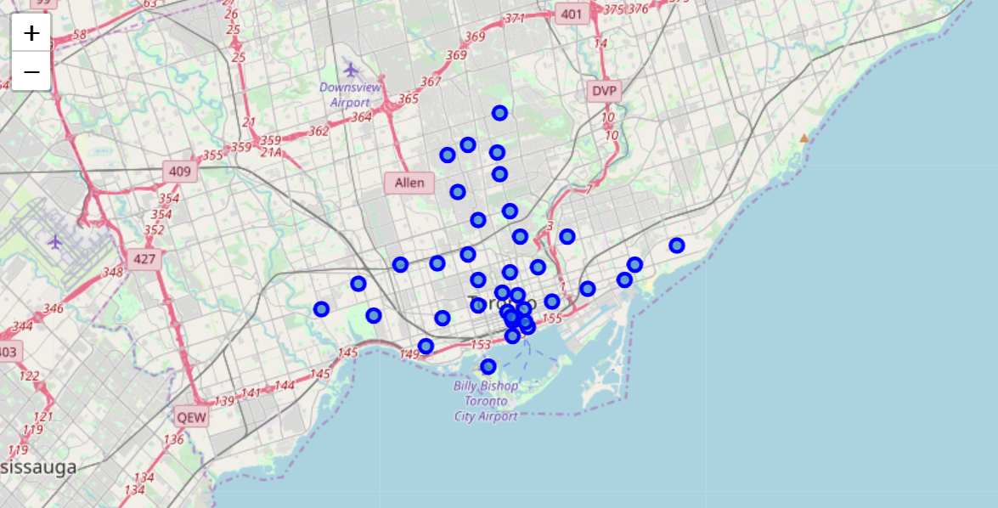
Toronto map

Slide 7
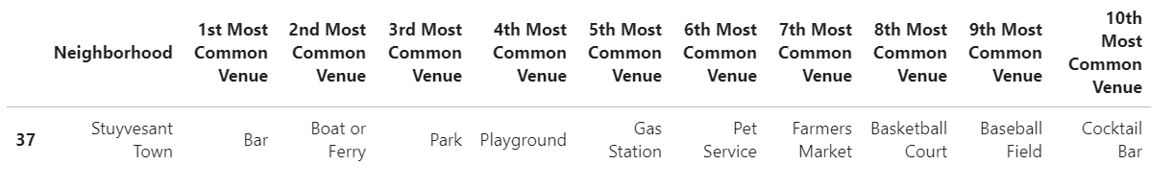
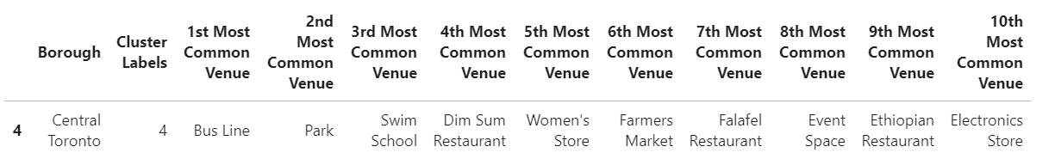
Cluster details
Manhattan Cluster:
Toronto Cluster:

Slide 8
Result & conclusion
For Manhattan with k-mean = 3, Discount Bar, Boat & Park are the top 3 common venues. For Toronto with k-mean = 5, Bus line, Park and Swim School are the top 3 common venues.
As you can see, the clustering is completely different, which mean, if tourist have to carefully select their city of visit as per preferences as identified in the clusters.

